Slide 1

C Project Proposal “Phonebook Management System”
By: Sanjina Rai

Slide 2
Introduction
“Phonebook” is a simple application, which is especially generated and designed for the users for file handling operations such as how to add, modify, list and delete phone records using file. There are more than 600 million mobile phone users around the world and its success lies in being available anytime and anywhere.
OBJECTIVES:
To develop an “Phonebook Management system” application using C programming language.
This program helps user to store complete information under single contact number.
User in this program has options to storage, deletion and modification of the entered contact.

Slide 3
Features:
Add phone record
Search phone record
Remove phone record
Modify phone record
Delete all content
Scope of the project:
To show the level of understanding and skills of students after learning c-programming.
To help student master the way of coding and programming using c application.
To check the skills of the student in using c program.
To utilize their learning and showcase their talent through this project.

Slide 4
Algorithm: Step 1: Start Step 2: Welcome To My Phonebook Step 3: Choose Option Step 4: If Choose=1 Then Go To List Person Step 5: Else If Choose=2 Then Go To Add Person Step 6: Else If Choose=3 Then Go To Search Person Record Step 7: Else If Choose=4 Then Go To Remove Person Step 8: Else If Choose=5 Then Go To Update Person Step 9: Else If Choose=6 Then Go To Delete All Content Step 10: Else Go To Exit Phonebook Step 11: End

Slide 5
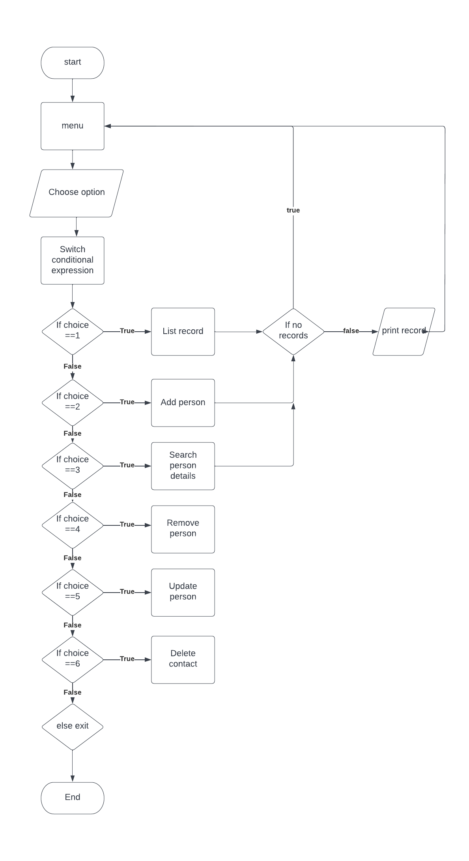
Flowchart:

Slide 6
Project schedule:
Week 1: Research about different kinds of projects
Week 2: Selection of the project
Week 3: Preparation of the proposal, flowchart and algorithm of selected project
Week 4-5: Coding started
Week 5-6: Researched and completed the introduction part
Week 7, 8 and 9: Coding completed
Week 10-11: Bug testing and any addition added
Week 12, 13, 14: Planning of report and report complete
Week 15: End of project

Slide 7
Conclusion:
The successful completion of the project “Phonebook Management System’, plays a role in making it easier for the user to perform simple phonebook operations like in your mobile. Through this project, users can add a new phone record, display existing phone records, search a particular phone record, update person detail and delete phone records. The main aim of this project is to teach people file handling operations such as how to add, search, modify, list and delete records using file.

Slide 8
Thank you!!☺☺

